Slide 1

Upload & Download a File

Slide 2
Introduction
Uploading is the process of putting web pages, images and files onto a web server.
Downloading is the process of getting web pages, images and files from a web server.

Slide 3
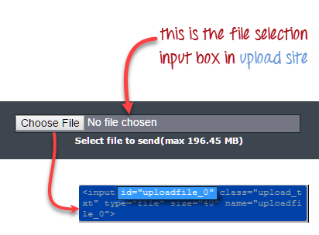
Uploading Files
Uploading files in WebDriver is done by using the sendKeys() method on the file-select input field to enter the path to the file to be uploaded.

Slide 4
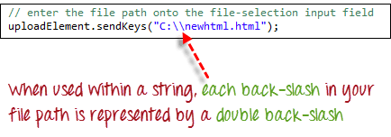
Now see the code here:-
when uploading files in WebDriver automatically enters the file path onto the file-selection text box of the <input type="file"> element.
When setting the file path in Java IDE, use the proper escape character for the back-slash .
WebElement uploadElement = driver.findElement(By.id("uploadfile_0”));
uploadElement.sendKeys("C:\\newhtml.html"); driver.findElement(By.id("terms")).click(); driver.findElement(By.name("send")).click();

Slide 5

Downloading Files
WebDriver has no capability to access the Download dialog boxes presented by browsers when you click on a download link or button, it can bypass these dialog boxes using a separate program called “Wget”.
Wget is a small and easy-to-use command-line program used to automate downloads.
See the Example:-

Slide 6

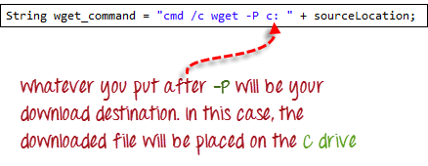
How to implement
Import the "java.io.IOException" package.
Use getAttribute() to obtain the "href" value of the download link and save it as a String variable. This variable named as "sourceLocation".
Set-up the syntax for wget using the following command.

Slide 7
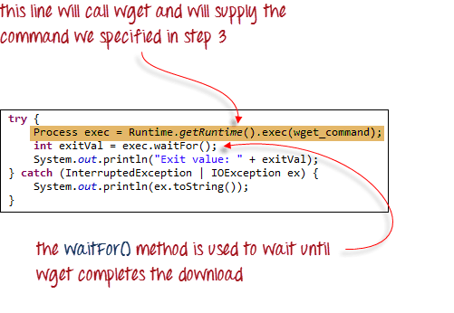
Initiate the download process by calling Wget from our WebDriver code.

Slide 8
Covered Till Now
Uploading files in WebDriver is done by simply using the sendKeys() method on the file-select input field to enter the path to the file to be uploaded.
WebDriver cannot automate downloading of files on its own.
The easiest way to download files using WebDriver is to use Wget.
.

Slide 9
Thanks

